Slide 1

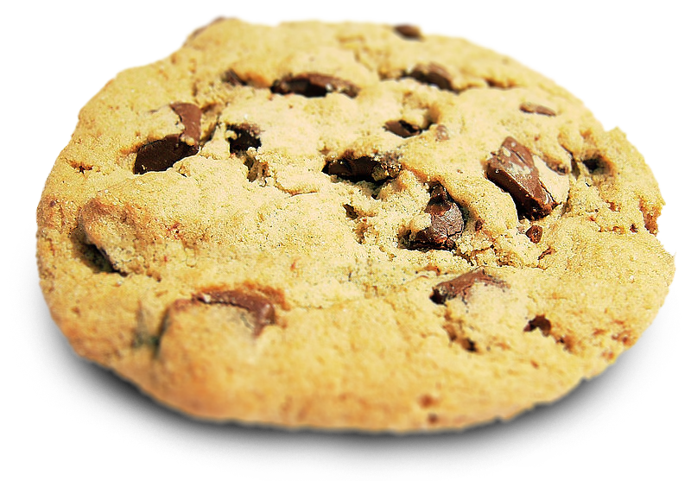

Cookies and Sessions
Charles Severance
www.dj4e.com

Slide 2

Browser
Linux
D
O
M
N
G
I
N X
WGSIConfig
settings.py
DJango
Click
Session
Middleware
Session
Storage
Parse
Response
urls.py
views.py
Templates
Javascript
forms.py
models.py
Database

Slide 3
Multi-User / Multi-Browser
When a server is interacting with many different browsers at the same time, the server needs to know *which* browser a particular request came from.
Request / Response initially was stateless - all browsers looked identical . This was really bad and did not last very long at all.

Slide 4
Web Cookies to the Rescue
Technically, cookies are arbitrary pieces of data chosen by the Web server and sent to the browser. The browser returns them unchanged to the server, introducing a state (memory of previous events) into otherwise stateless HTTP transactions. Without cookies, each retrieval of a Web page or component of a Web page is an isolated event, mostly unrelated to all other views of the pages of the same site.
http://en.wikipedia.org/wiki/HTTP_cookie

Slide 5
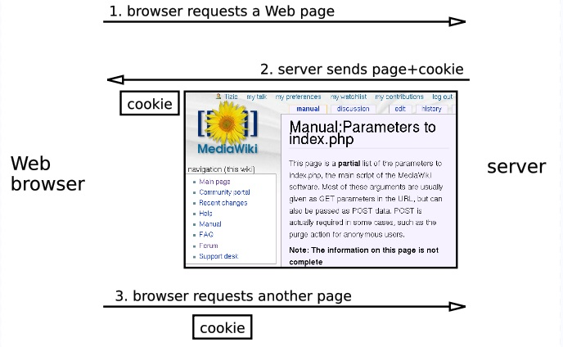
http://en.wikipedia.org/wiki/HTTP_cookie

Slide 6
Cookies In the Browser
Cookies are marked as to the web addresses they come from. The browser only sends back cookies that were originally set by the same web server.
Cookies have an expiration date. Some last for years, others are short-term and go away as soon as the browser is closed

Slide 7
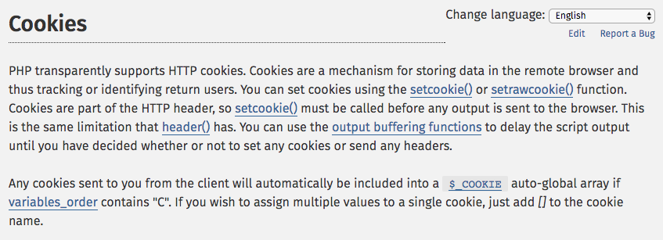
http://php.net/manual/en/features.cookies.php

Slide 8
def cookie(request):
print(request.COOKIES)
resp = HttpResponse('C is for cookie and that is good enough for me...')
resp.set_cookie('zap', 42) # No epired data = until browser close
resp.set_cookie('sakaicar', 42, max_age=1000) # seconds until expire
return resp
https://github.com/csev/dj4e-samples/blob/master/session/home/views.py

Slide 9
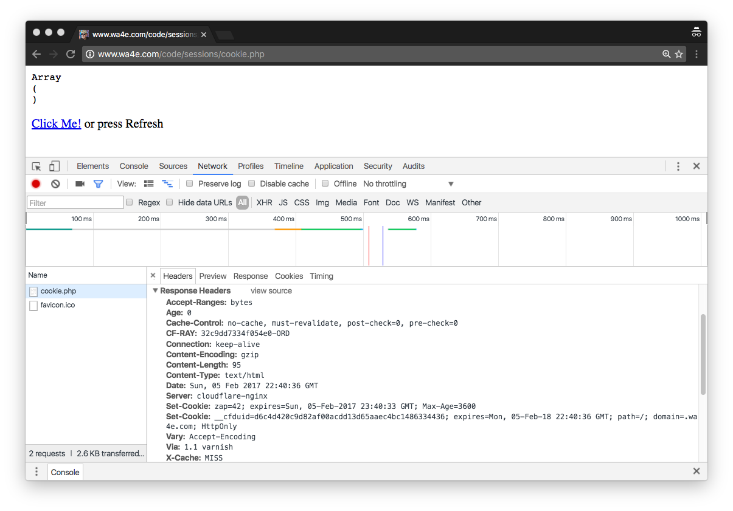

http://www.wa4e.com/code/sessions/cookie.php
In a fresh/incognito browser.

Slide 10
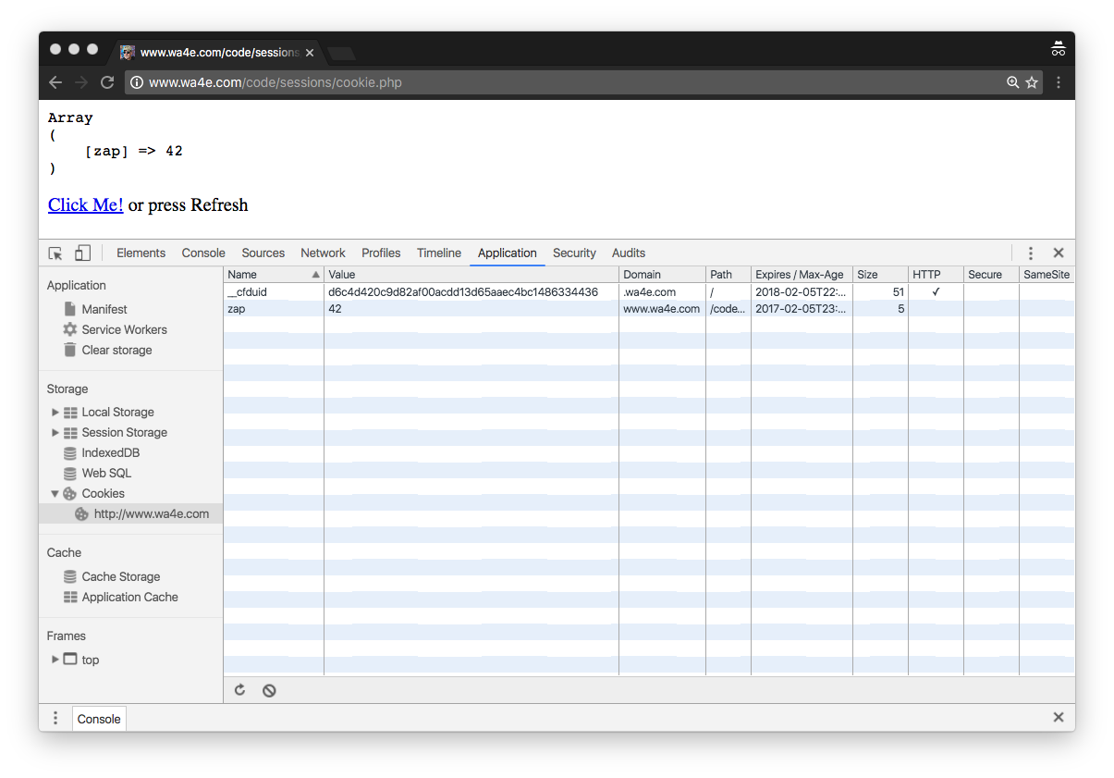
http://www.wa4e.com/code/sessions/cookie.php
In a fresh/incognito browser.
Examine Cookies

Slide 11
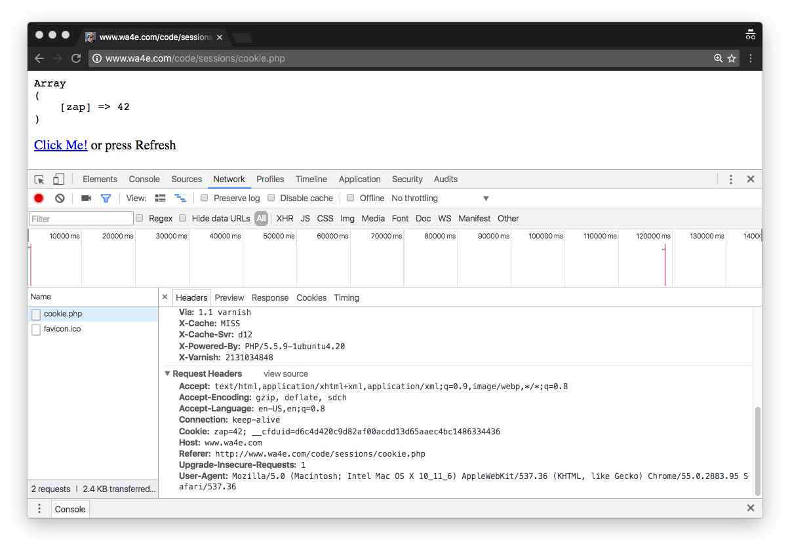
http://www.wa4e.com/code/sessions/cookie.php
In a fresh/incognito browser.
Press Refresh

Slide 12

Time
Browser
Browser zap=42
Browser zap=42
Browser zap=42
zap=42
Apache
setcookie()
$_COOKIE
$_COOKIE
$_COOKIE
PHP
Code

Slide 13
PHP Sessions
http://www.wa4e.com/code/sessions.zip

Slide 14
Time
Browser
Web Server
Database Server
DOM
Sessions:
42
6f
3e
MySql
Send
Request
Apache
Parse
Response
PHP
sessfun.php
PDO
JavaScript
RRC/HTTP
SQL

Slide 15
In the Server - Sessions
In most server applications, as soon as we meet a new (unmarked) browser we create a session.
We set a session cookie to be stored in the browser, which indicates the session id in use – gives this browser a unique “mark”.
The creation and destruction of sessions is handled by a web framework or some utility code that we use in our applications.

Slide 16
Session Identifier
A large, random number that we place in a browser cookie the first time we encounter a browser
This number is used to pick from the many sessions that the server has active at any one time.
Server software stores data in the session that it wants to have from one request to another from the same browser.
Shopping cart or login information is stored in the session in the server.

Slide 17
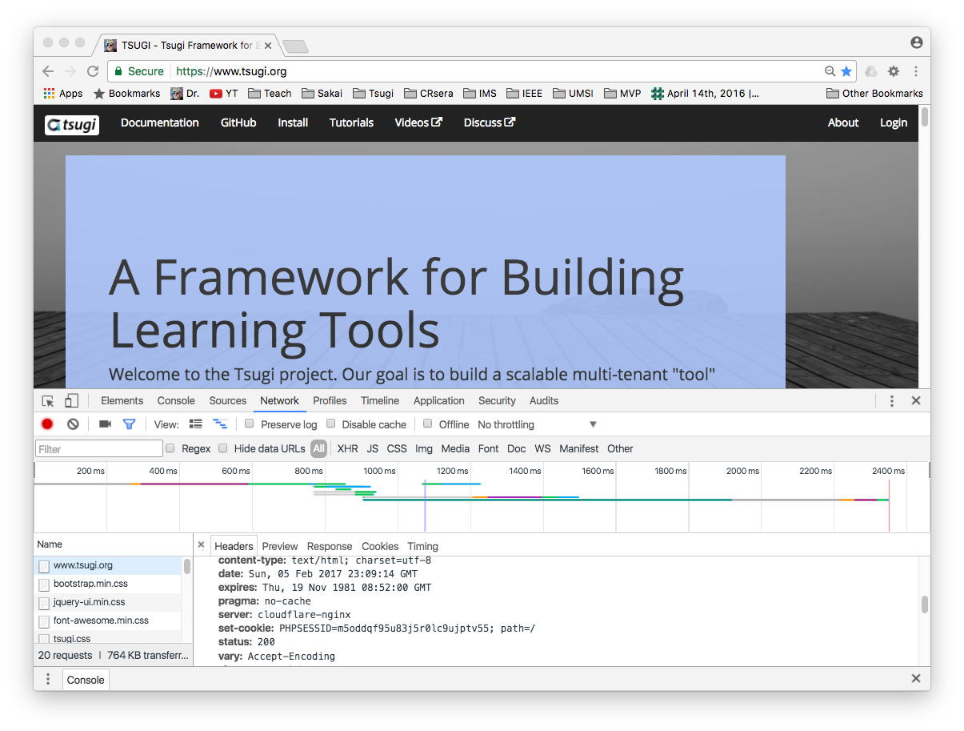
Open a fresh browser.
Turn on network tab of developer console.
Go to www.tsugi.org
Find the first page retrieved.
Look at the response headers and find set-cookie.

Slide 18
Space
Browser S=A123
Browser S=B345
Browser S=C678
Web Server
PHP
PHP
Code
A123
B345
C678

Slide 19
PHP Sessions
We can establish / initialize a PHP session by calling session_start() before any output has come out.
If the user has cookies set, we can use the array $_SESSION to store data from one request to the next with a particular browser.
We have a bit of data that persists from one request to the next.
By default, these are stored in a temporary folder on disk.

Slide 20
Time
Browser S=C123
Browser S=C123
Browser S=C123
Browser S=C123
Apache
PHP
$_POST
$_SESSION
PHP
$_GET
$_SESSION
PHP
$_POST
$_SESSION
...
PHP
$_POST
$_SESSION
PHP
Code
C123

Slide 21
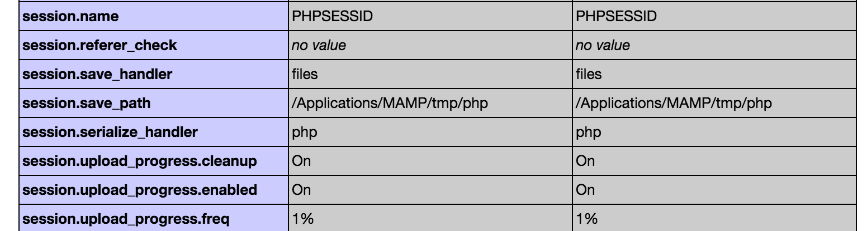
PHPInfo – session.save_path

Slide 22
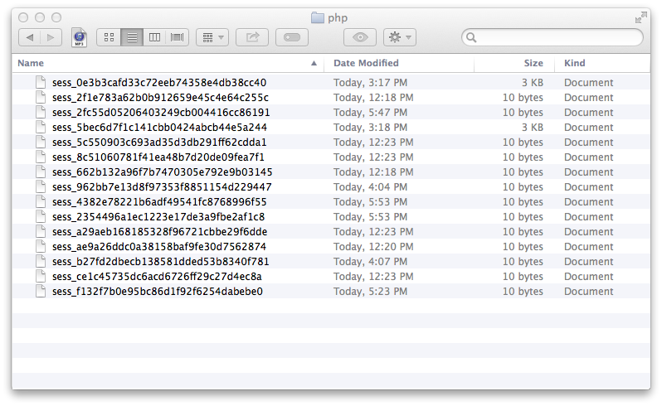
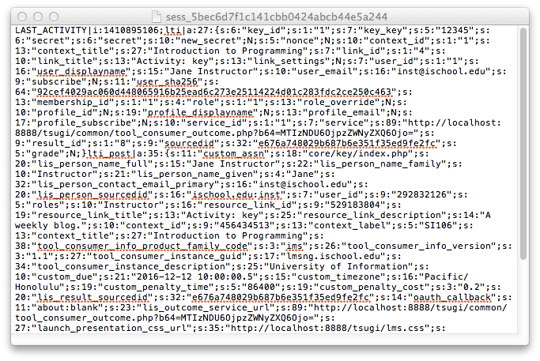
(On a Mac) /Applications/MAMP/tmp/php

Slide 23
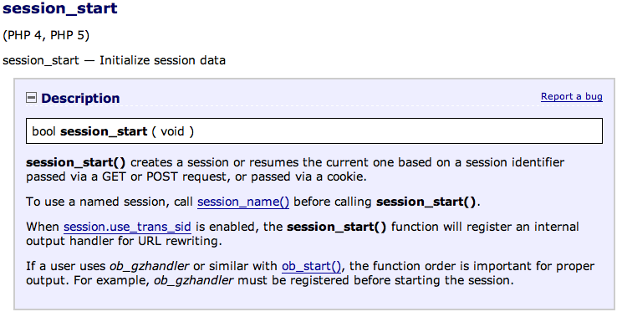
http://php.net/manual/en/function.session-start.php

Slide 24
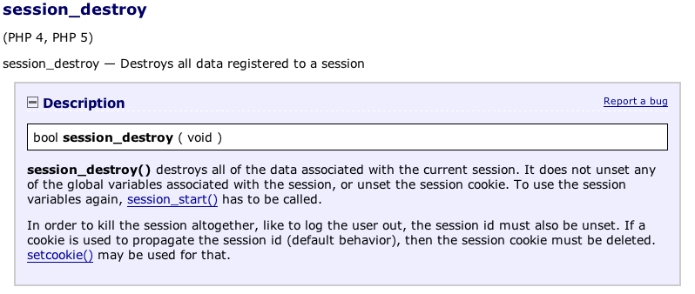
http://php.net/manual/en/function.session-destroy.php

Slide 25
def sessfun(request) :
context = {'zap' : '42' }
num_visits = request.session.get('num_visits', 0)
request.session['num_visits'] = num_visits + 1
return HttpResponse('click count='+str(request.session['num_visits']))
http://www.wa4e.com/code/sessions/sessfun.php

Slide 26
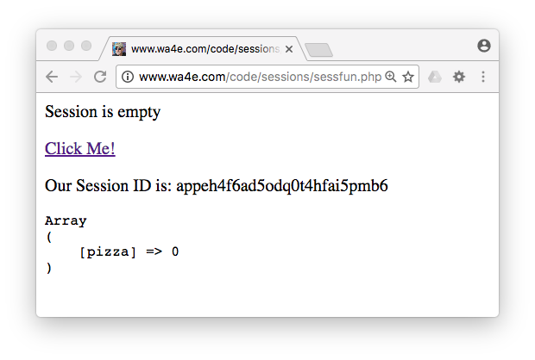
http://www.wa4e.com/code/sessions/sessfun.php

Slide 27
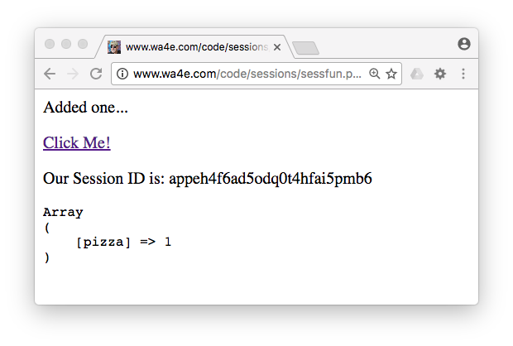


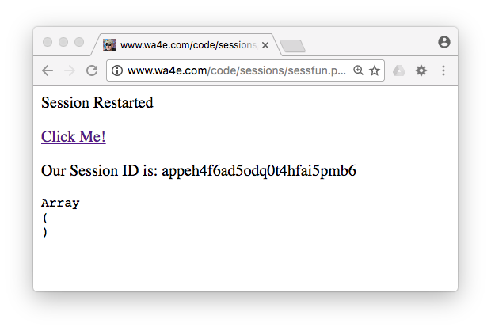
http://www.wa4e.com/code/sessions/sessfun.php

Slide 28
Summary
HTTP Cookies
Sessions
Using Sessions in Django

Slide 29
Acknowledgements / Contributions
These slides are Copyright 2010- Charles R. Severance (www.dr-chuck.com) as part of www.wa4e.com and made available under a Creative Commons Attribution 4.0 License. Please maintain this slide in all copies of the document to comply with the attribution requirements of the license. If you make a change, feel free to add your name and organization to the list of contributors on this page as you republish the materials.
Initial Development: Charles Severance, University of Michigan School of Information
Insert new Contributors and Translators here including names and dates
Continue new Contributors and Translators here
Notes:
Note from Chuck. Please retain and maintain this page as you remix and republish these materials. Please add any of your own improvements or contributions.

Slide 30
Copyright Attribution
Cookie Image: By brainloc on sxc.hu (Bob Smith) (stock.xchng) [CC BY 2.5 (http://creativecommons.org/licenses/by/2.5)], via Wikimedia Commons

